Slide 1
Scanning activity
18700714
Jamin andong

Slide 2
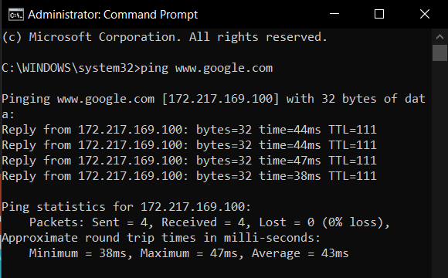
ping

Slide 3
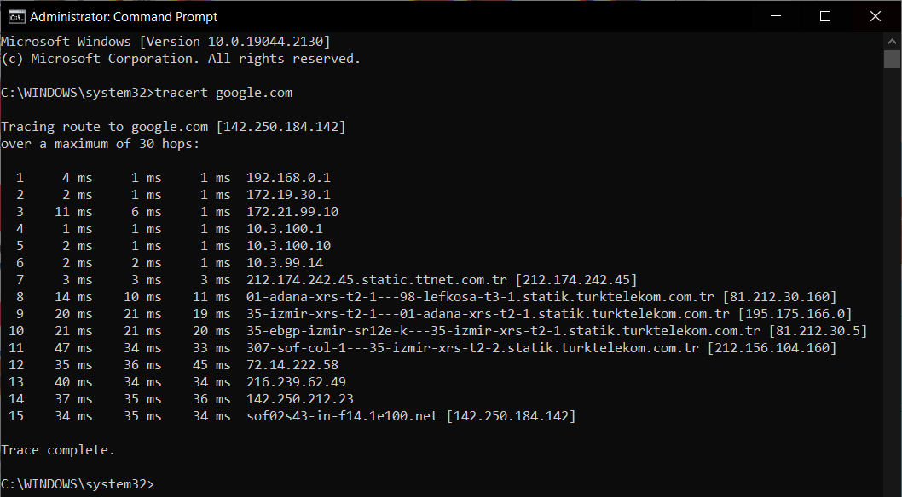
Tracert
-The following tracert command returned 15 hops to
and from google.com
-Step 11 appears to have caused the biggest delay at 47ms, with an average of 38.

Slide 4

nslookup

Slide 5
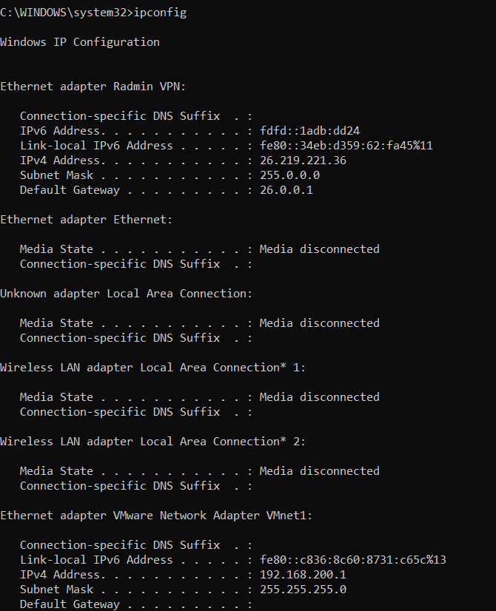
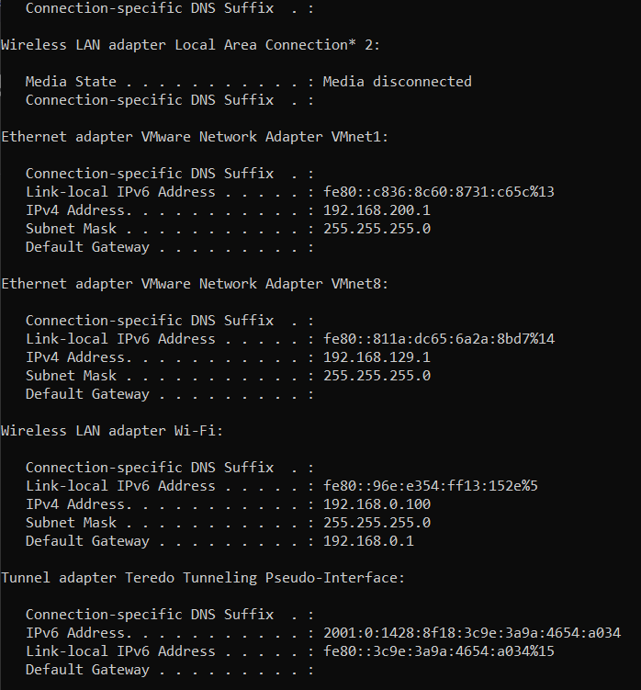
Ipconfig

Slide 6
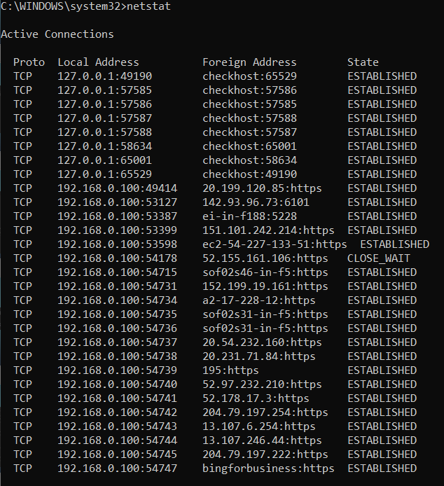
Netstat

Slide 7
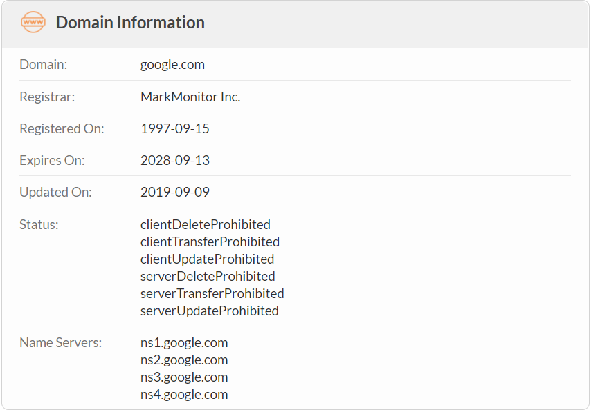
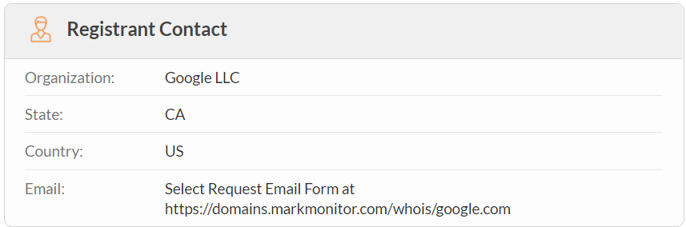
Registered contact & main nameservers

Slide 8
References
https://www.whois.com/whois/google.com

